Slide 1
Refilling Pallet Magnet Oil Reservoir
6.27.24 version 1.0

Slide 2
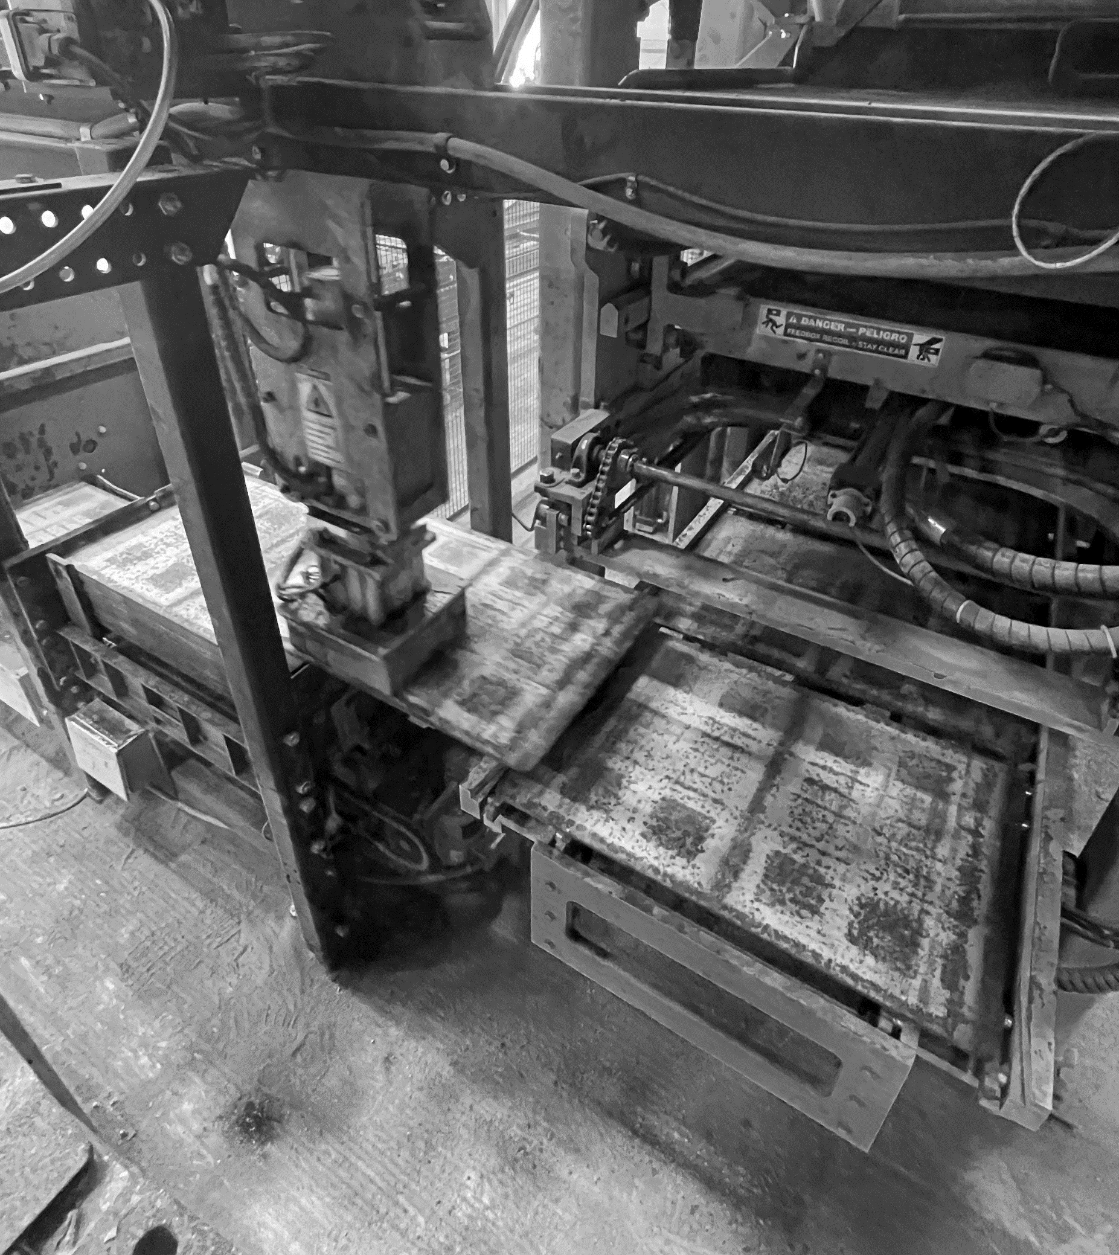
Assumptions and Prerequisite Skills
Oil reservoir for the pallet magnet is getting low
The Besser machine is currently not active (Control set to manual/single cycle)
Supplies Needed
Standard PPE
Ladder
Air tool oil container
1 blue surface rag

Slide 3
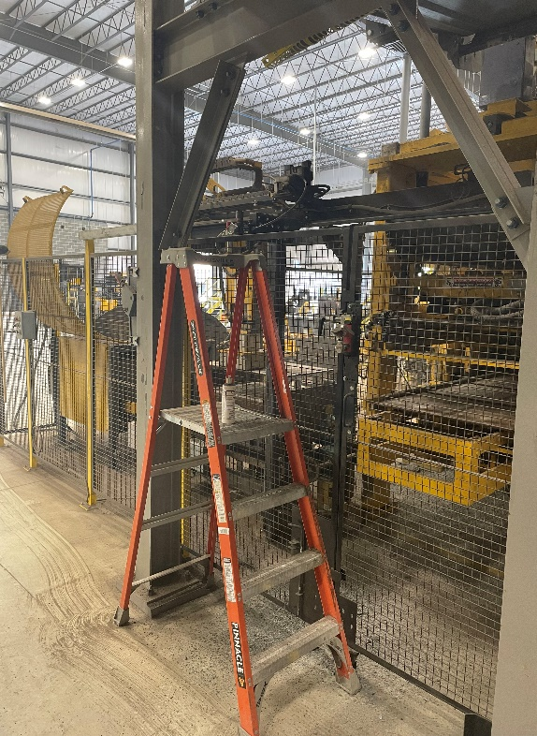
Procedure
1. Set up a ladder on the backside of the Besser machine underneath the machine belt (Figure 1).
Figure 1

Slide 4
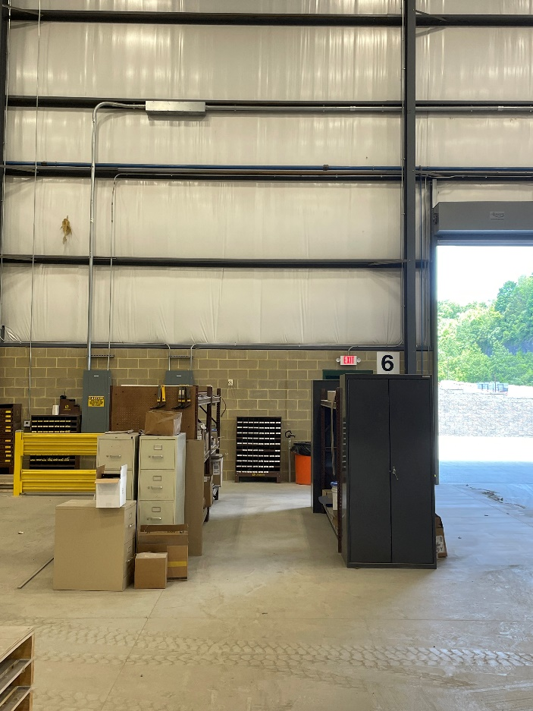
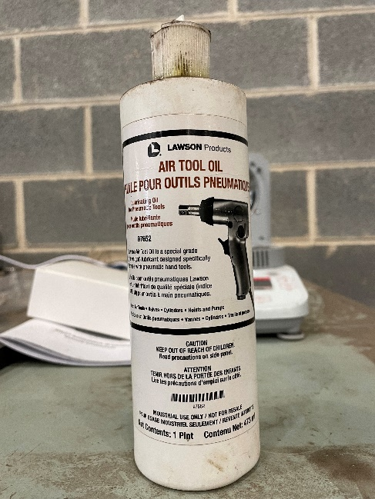
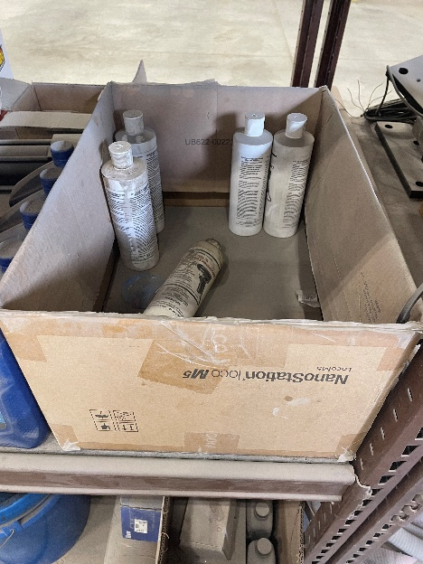
Procedure
2. Get a bottle of air tool oil from the left side of the shelves (Figure 2).
Figure 2C
Figure 2A
Figure 2B

Slide 5
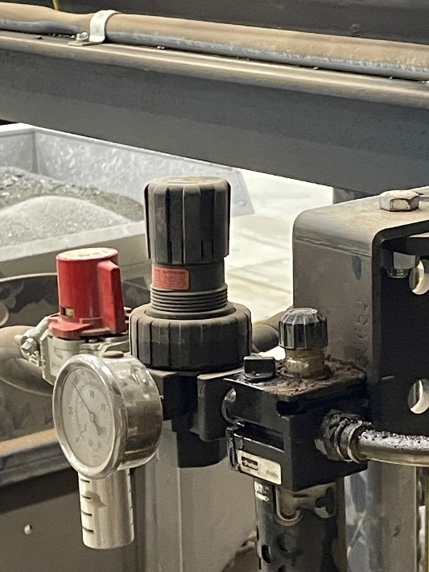
Procedure
3. Rotate the red cap counterclockwise until you can no longer twist (Yellow circle in Figure 3).
Figure 3

Slide 6
Procedure
4. Take a blue surface rag and wipe down the area around the smallest black cap (Blue circle in Figure 4). This is to prevent any dust or debris from entering the reservoir.
5. Twist the smallest black cap until it comes off (Blue circle in Figure 4).
Figure 4

Slide 7
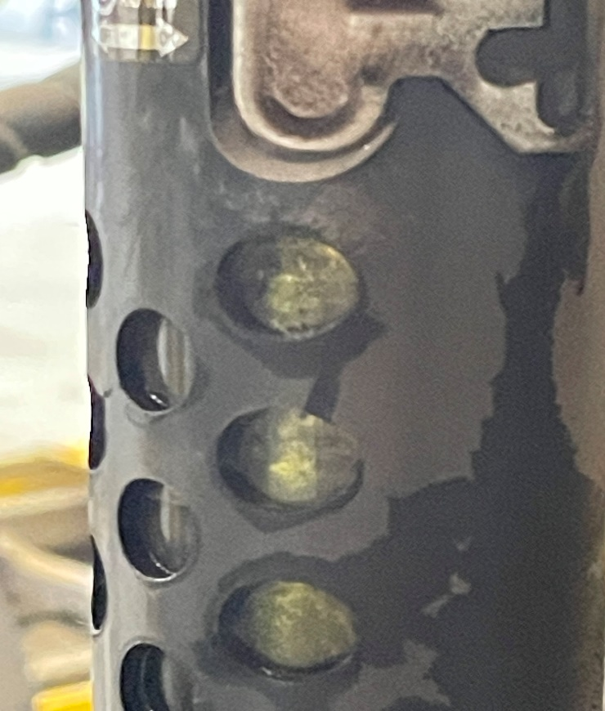
Procedure
6. Fill the reservoir until the third window up is filled with oil (Use windows in Red oval in Figure 5 to fill up).
7. Screw the black cap back on and turn the red cap clockwise until it locks. Be sure to return your materials back where you found them.
Figure 5

